Slide 1
The job quality of key worker employees: Analysis of the Labour Force Survey
Working paper (Available to download here https://openaccess.city.ac.uk/id/eprint/24254/)
By Matt Barnes, Nhlanhla Ndebele and Eric Harrison
Department of Sociology
City, University of London

Slide 2
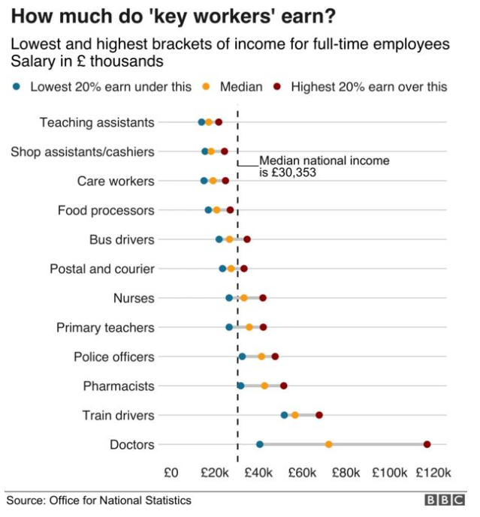
Key workers and the pandemic
Key workers critical to running the country during pandemic
Challenging work conditions e.g. health and mortality risks of frontline workers (Kikuchi and Khurana, 2020; ONS, 2020)
Led to discussions of how much society values key workers more generally, with a focus on pay
Many key workers paid less than the average employee (Butcher, 2020; Farquharson et al, 2020)
With certain groups of key workers disproportionately earning less - women, ethnic minorities, lower educational qualifications (Cominetti et al, 2020)
Butcher (2020)

Slide 3
Aims of our research
Missing from debate is broader understanding of the usual ‘job quality’ of key workers - security of work, work patterns, progression opportunities etc
We illustrate the job quality of selected key worker occupations by analysing data from the Labour Force Survey
Can we produce a relatively quick, but robust, analysis to contribute to the current debate about valuing key worker jobs?
We explore:
What is the job quality of (selected) key workers occupations and how does it compare to that of the average employee?
How does job quality sit with pay?
Which key worker occupations have the lowest job quality and lowest pay?

Slide 4
DATA AND DEFINITIONS

Slide 5
Data and definitions
Labour Force Survey
Key source of labour market statistics in the UK
Government funded representative survey takes place every quarter year
Questions on employment, unemployment, economic inactivity and personal characteristics
Some questions asked every quarter, others less regularly
Nearly 90,000 adult respondents per survey
Our analysis of the LFS
We pool data from 2016-2019 to increase sample size
This allows us to look at specific occupations
We pool quarters of data from new entrants into the LFS
We do that for three separate years (Q1-Q4 2019, Q1-Q4 2018, Q1-Q42017, Q1-Q4 2016)
Some variables are just in one quarter, so we pool just those quarters going back four years
So we capture ‘usual’ job quality, before the pandemic

Slide 6
Job quality
Difficult to precisely define
Multiple aspects, and multiple indicators could be used to capture each
Government has been recommended ‘Good work’ indicators – LFS has questions in a number of these dimensions
We use nine indicators of negative job quality
plus pay (from Annual Survey of Hours and Earnings)
Irvine et al (2018)

Slide 7
Job quality measures (1)
[Nhlanhla]
1. Working long hours (measured for full-time employees)
Q. How many hours per week do you usually work in your (main) job/business – please exclude meal breaks?, and, How many hours paid/unpaid overtime do you usually work per week?
2. Working evenings and nights
Q. Within your usual pattern of work is it usual for you to work in the evening, or at night?
3. Working at the weekend
Q. On how many (different) days per week do you usually work?, May I just check, on which days do you usually work?
4. Shift work
Q. Do you do shift work in your job?

Slide 8
Job quality measures (2)
[Nhlanhla]
5. Not having a permanent job
Q. Is your job... a permanent job, or is there some way that it is not permanent?
6. Having a zero-hours contract
Q. Some people have special working hours arrangements that vary daily or weekly. In your (main) job is your agreed working arrangement any of the following…zero hours contract?
7. Suffering from an illness or disability caused by work
Q. Within the last twelve months have you suffered from any illness, disability or other physical or mental problem that was caused or made worse by your job or by work you have done in the past?

Slide 9
Job quality measures (3)
[Nhlanhla]
8. Not being offered training or education by the employer
Q. In the last 3 months, has your (previous or current) employer offered you any training or education either on, or away from, your job?
9. Pay and conditions not influenced by trade union
Q. Are your pay and conditions of employment directly affected by agreements between your employer and any trade union or staff association?

Slide 10
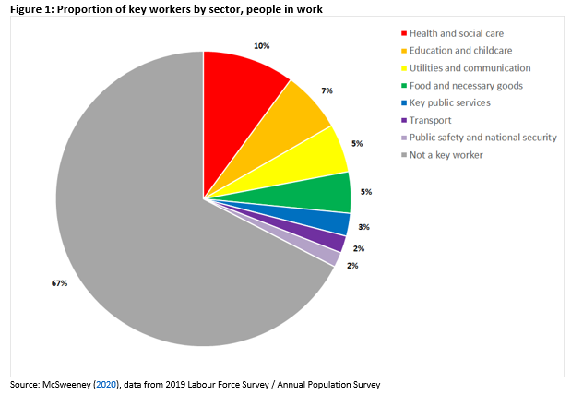
Key workers
Government definition of those whose work is critical to the
Covid-19 response (Cabinet Office, 2020; Farquharson et al, 2020)
These occupations can be identified in the LFS using
a 4-digit Standard Occupational Classification e.g. medical
practitioners (SOC code 2211), nurses (SOC code 2231)
Approximately 1/3 of the workforce are key workers
The vast majority are employees (we focus only on employees)
We focus on some selected key worker occupations:
Health: Medical practitioners, Nurses, Care workers, and Cleaners
Education: Primary school teachers, Teaching assistants, Social workers, and Nursery nurses
Utilities: Postal workers
Food: Checkout staff, and Food and drink process operatives
Public services: Welfare and housing advisors
Transport: Large goods vehicle drivers, Bus drivers
Public safety: Police officers, and Security guards
Chose as interesting, mainly frontline occupations - and big sample size
Sample size of occupations varies from ~350 (social workers) to ~2,650 (care workers)

Slide 11
FINDINGS

Slide 12
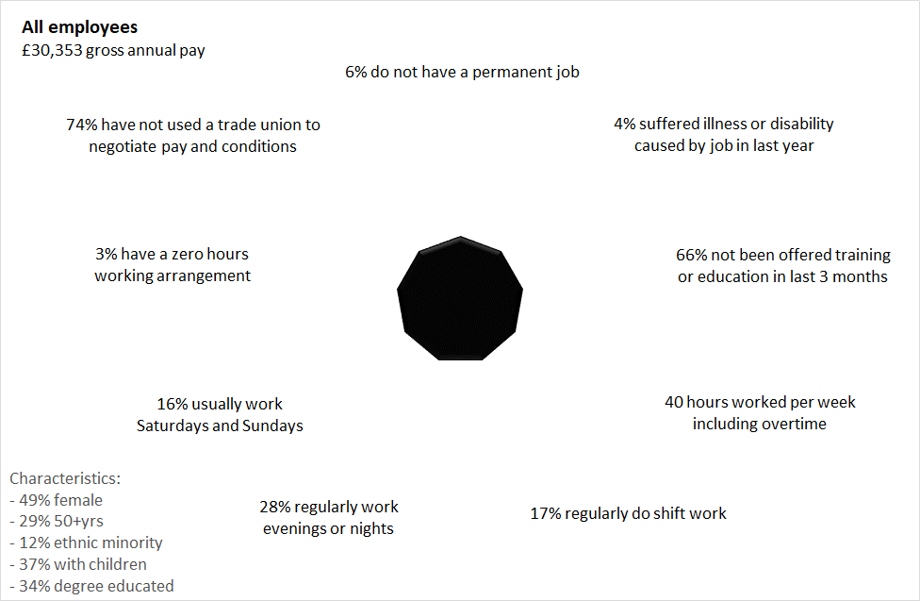
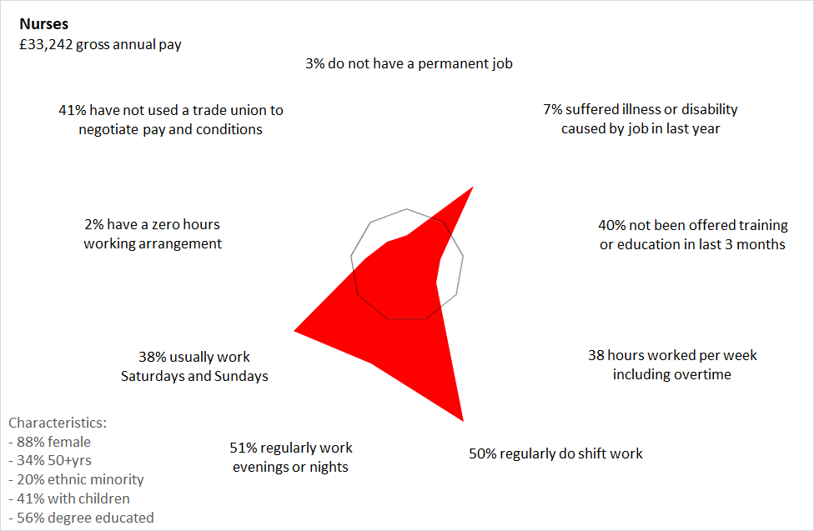
Radar charts represent job quality
Black nonagon represents the average employee
6% of employees do not have a permanent job etc.
49% of employees are female etc.
Charts calculated for each key worker occupation
Chart outside nonagon indicates lower job quality
e.g. nurses more likely to suffer illness, work shifts, evening/nights, and weekends

Slide 13
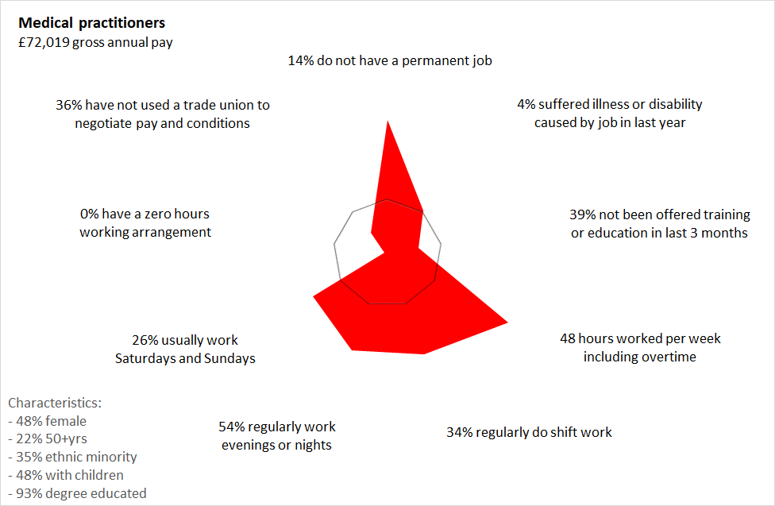
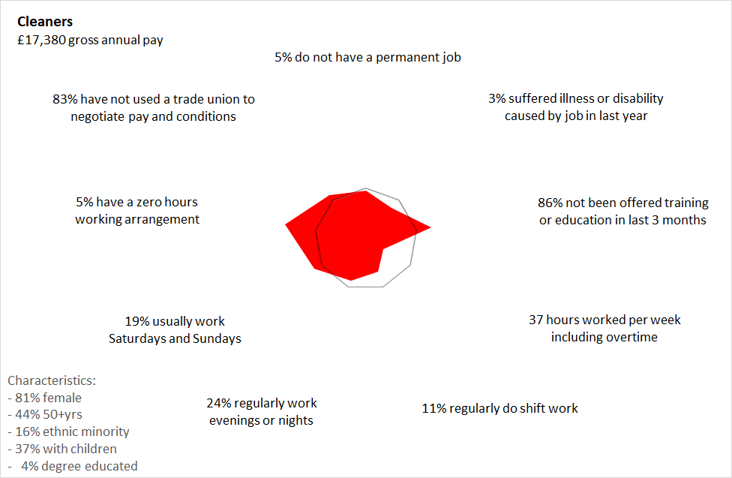
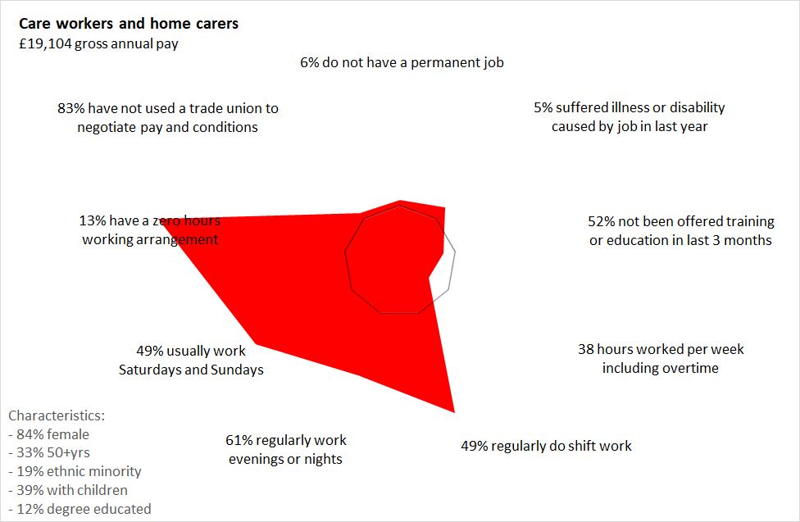
Variation in job quality within sectors
Within health sector, for example, variation in pay and job quality
Care workers on low pay and lower job quality
Care workers disproportionately women, ethnic minorities, and lower education
Pay associated with educational qualifications

Slide 14
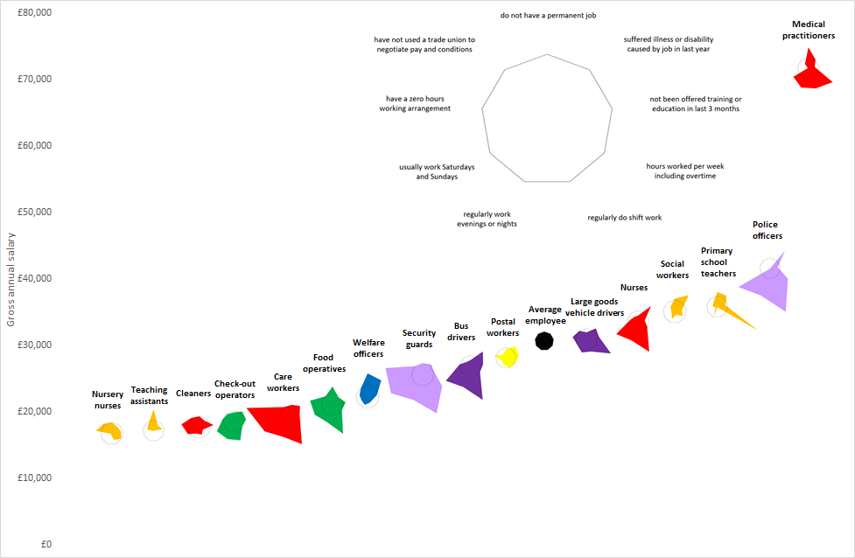
Job quality and pay
Many key workers not only receive low pay but also experience lower job quality than the average employee, notably:
Care workers
Food operatives
Security guards
Bus drivers

Slide 15
SUMMARY AND NEXT STEPS

Slide 16
Summary findings
[Eric]
Variations in pay and job quality
Key workers and ‘anti-social’ hours
Reflection of some occupations
Repercussions for health, sleep, social contact
Some occupations fare markedly worse than others
Socio-demographic divisions
Gender
Ethnic minorities

Slide 17
Limitations and next steps
[Eric]
Limitations of this (quickly produced) research
Limited range of job quality indicators and occupations
Some indicators correlated
Next steps
Annual Population Survey has more indicators of job quality
‘Good Work’ measure/index
Sector level analysis (using ONS definition)
Compare keyworkers’ job quality, and wellbeing, in the pandemic
Explore socio-demographic/economic inequalities in more depth
Gender, Ethnicity, Class
Explore duration and changes in quality of work (Nhlanhla’s PhD)

Slide 18
Barnes, M., Ndebele, N. and Harrison, E. (2020) The job quality of key worker employees: Analysis of the Labour Force Survey, Working Paper, London: City, University of London
Available to download here https://openaccess.city.ac.uk/id/eprint/24254/
Matt.Barnes@city.ac.uk
Nhlanhla.Ndebele.2@city.ac.uk
Eric.Harrison.2@city.ac.uk
City, University of London
Northampton Square
London
EC1V 0HB
United Kingdom
www.city.ac.uk/sociology
www.city.ac.uk/about/schools/arts-social-sciences/sociology/city-q-step-centre

